Slide 1
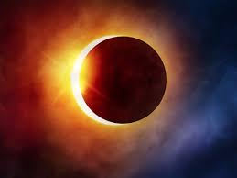
BASIC INTRODUCTION TO IMAGE PROCESSING
Yemi .O
08/24/2017

Slide 2
Agenda
Background
Image - Pixel Concept
Types of Images
RGB Model & Color Code
Color Quantization
Basic Manipulation
Application
R packages
R Script

Slide 3
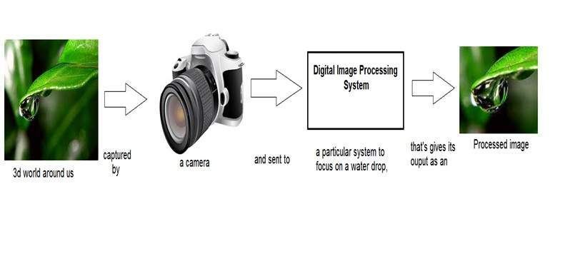
Background
Conversion of 2D spatial information in images into other forms that can be used for content characterization
Image processing deals with manipulation of digital images through a digital computer
AI Subfield: Computer Vision

Slide 4
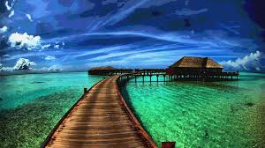
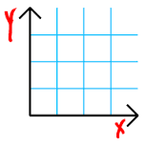
Image: Definition
2 D signal
It is defined by the mathematical function f(x,y)
x and y are the two co-ordinates
two dimensional array of numbers ranging between 0 and 255.

Slide 5
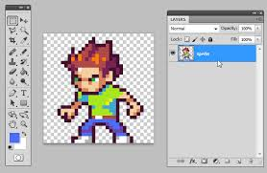

Image: Pixel (PEL)
Pixel is the smallest element of an image
Each pixel correspond to any one value.
The value of a pixel at any point correspond to the intensity of the light photons striking at that point
Bits per pixel (Bpp) denotes the number of bits per pixel.
The number of different colors in an image depends on the depth of color or bits per pixel.
Numbers represented by one bit (0,1)
In an 8-bit gray scale image, the value of the pixel between 0 and 255.

Slide 6


Image: Types
Binary image
Two pixel values (0,1)
- Monochrome
- Format: Portable Bit Map (PBM)
8 bit Color
256 different shades of colors
Grayscale image.
Color range: 0-255. {0: black,127 : Gray, 255 : White}
Format: Portable Gray Map (PGM)
Matrix size: 1

Slide 7
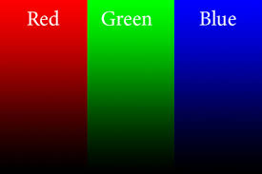
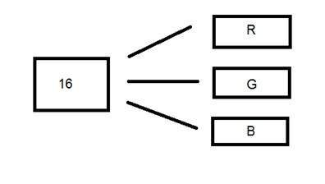
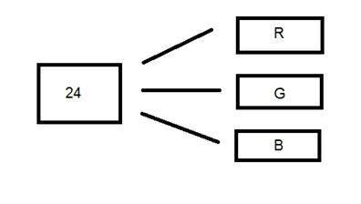
Image: Types
16-bit color format
Known as high color image format
Red ,Green and Blue (RGB) format
65,536 different colors
24- bit color format
True color format
RGB
Format: Portable PixMap (PPM)
Matrix size: 3

Slide 8
Image: RGB Model/Color Codes
Using the RGB model
Binary color
Color: Black ; white
Decimal code: (0,0,0); (255,255,255)
RGB Model
Color: Red;Green
Decimal code: (255,0,0);(0,255,0);(0,0,255)
Gray Color
Decimal code:(128,128,128)

Slide 9
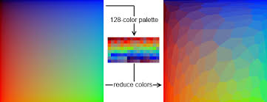
Image: Color Quantization
Division of a signal into partitions(quanta)
Color quantization is applied when the color information of an image is to be reduced.
24-bit color image is transformed into an 8-bit color image

Slide 10
Image : Manipulation
Brightness & Contrast
Gamma Correction
Color Change
Blurring

Slide 11
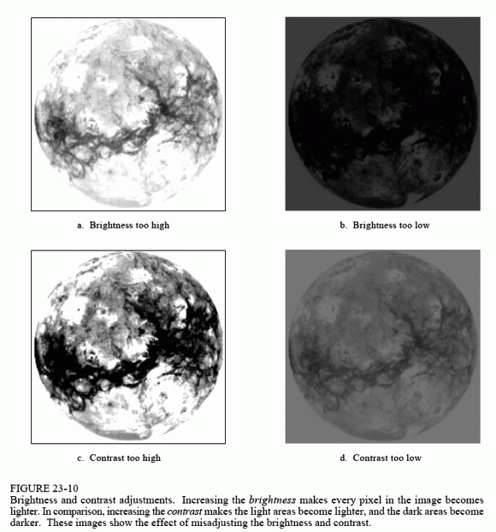
Brightness & Contrast
Brightness
Brightness refers to the overall lightness or darkness of an image
Brightness can be increased or decreased by addition (+) or subtraction(-), to the image matrix.
Contrast
Contrast is the difference between maximum and minimum pixel intensity in an image.

Slide 12
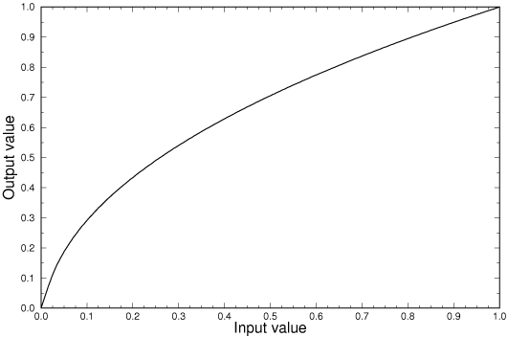
Gamma Correction
Gamma correction
non-linear adjustment to individual pixel values
Defines the relationship between a pixel’s numerical value and its actual luminance
defined by the power-law expression
(where A is a constant and the input and output values are non-negative real values; in the common case of A = 1, inputs and outputs are typically in the range 0–1.)
y < 1 : Gamma compression
Gamma encoding is used to increase the quality of shadow values when an image is stored as integer intensity values, so to do gamma encoding you use the formula:
encoded = ((original / 255) ^ (1 / gamma)) * 255
y>1 : Gamma expansion
Gamma decoding is used to restore the original values, so the formula for that is:
original = ((encoded / 255) ^ gamma) * 255

Slide 13
ColorMode
Grayscale
Monochrome
Color

Slide 14
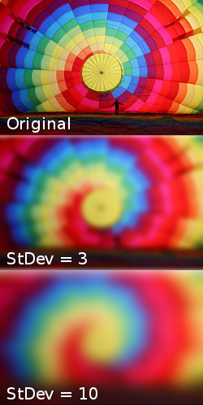


Blurring: Gaussian function
Result of blurring an image by a Gaussian function
The Gaussian blur is a type of image-blurring filter that uses a Gaussian function for calculating the transformation to apply to each pixel in the image.
**(G expresses the normal distribution in statistics)

Slide 15
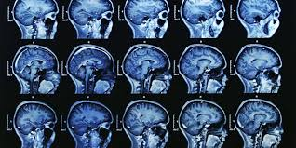
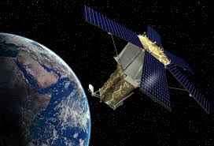
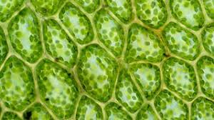

Applications of Digital Image Processing
Medical field
Remote sensing
Microscopic Imaging
Social media

Slide 16
Image : R packages
EBImage
Imager
ImageMagick

